Slide 1

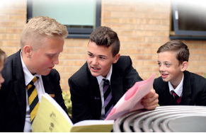
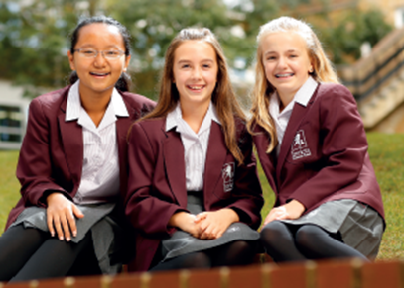
What do I stand for!
PESE
Procedure for Entry into Secondary Education
Tonight’s Meeting:
PESE
Admissions process into Secondary school
Kent Test process
Kingswood Residential
St Nicholas-at-Wade CE Primary A Place to Belong, A Place to Grow

Slide 2

What do I stand for!
A Milestone
Leaving Primary School
One or two teachers
One class
Small environment
School day
Entering Secondary School
Lots of teachers
Different classes/groups
Large environment
St Nicholas-at-Wade CE Primary A Place to Belong, A Place to Grow

Slide 3
What do I stand for!
The Years Ahead
Secondary Selection Process
Key Stage 2 SATs (Standard Assessment Tests)
Move to secondary school
GCSEs
A Levels/IB
Many other qualifications
University
College
Work
Not necessarily in that order
St Nicholas-at-Wade CE Primary A Place to Belong, A Place to Grow

Slide 4

What do I stand for!
School Types
Grammar:
Grammar schools and those Academies which select their intake through
the 11+ assessment procedure are by definition selective schools.
More academically able
Particular talents
25% of the top ability range in Kent
Fast pace
St Nicholas-at-Wade CE Primary A Place to Belong, A Place to Grow

Slide 5
What do I stand for!
School Types
All-ability (comprehensive schools)
Mixed ability
Most children
Slower pace if necessary
Special Schools
Independent Schools
St Nicholas-at-Wade CE Primary A Place to Belong, A Place to Grow

Slide 6

What do I stand for!
No Door is shut!
Opportunity
Curriculum
Character development
Work ethic
St Nicholas-at-Wade CE Primary A Place to Belong, A Place to Grow

Slide 7
What do I stand for!
Choices
Grammar:
Chatham and Clarendon Grammar School
Dane Court
Sir Roger Manwood
Simon Langton girls/boys
Barton Court
High School:
Ursuline *
King Ethelbert’s
Sandwich Tech
Charles Dickens
St. Georges CE*
Spires Academy
* = Supplementary Information form required (SIF)
St Nicholas-at-Wade CE Primary A Place to Belong, A Place to Grow

Slide 8
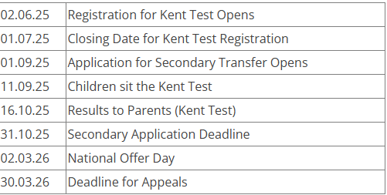
What do I stand for!
PESE Process: Key Dates
Follow the link below to register:
https://www.kent.gov.uk/education-and-children/schools/school-places/kent-test
St Nicholas-at-Wade CE Primary A Place to Belong, A Place to Grow

Slide 9

What do I stand for!
Opens June 2nd
https://www.kent.gov.uk/education-and-children/schools/school-places
St Nicholas-at-Wade CE Primary A Place to Belong, A Place to Grow

Slide 10
Admissions Process into Secondary
There will be a standard form known as a Secondary Common Application Form (SCAF).
Parents will be invited to express four preferences in priority order.
Some schools may ask parents to provide additional information on a supplementary form; this must be returned to the school you are applying to. This is not an application form; the only valid application form is the SCAF.
The SCAF needs to be completed by 31st October 2025.
March 2026 - all parents will be notified of the school allocated for their child.
St Nicholas-at-Wade CE Primary A Place to Belong, A Place to Grow

Slide 11
Admissions Process into Secondary
Many of the Thanet schools were oversubscribed last year.
You MUST fulfil the admissions criteria for a school in order to be offered a place.
School | Places Available | Applications received | Places offered | LA Allocation
Charles Dickens | 232 | 780 | 231
Chatham and Clarendon | 180 | 935 | 164
Dane Court | 165 | 924 | 163
Hartsdown | 180 | 167 | 178 | 82
King Ethelbert | 150 | 828 | 158
The Royal Harbour Academy | 200 | 263 | 176 | 40
St George’s | 217 | 1057 | 217
Ursuline | 150 | 783 | 149
Who are, or have previously been, in care or looked after
Siblings
Catchment
From a particular religion (for faith schools)
Kent Test (for grammar
St Nicholas-at-Wade CE Primary A Place to Belong, A Place to Grow

Slide 12

Making a decision
Secondary school literature and websites
Open evenings
Visit schools
Talk to your child about their thoughts
Talk to other parents
Talk to class teacher
Look back on school reports
St Nicholas-at-Wade CE Primary A Place to Belong, A Place to Grow

Slide 13
What do I stand for!
Kent Test
Paper 1
Multiple Choice English and Mathematics 30 mins each section including practice questions
Paper 2
Multiple Choice Reasoning - looks at how quickly and efficiently children solve problems.
30 mins each section:
Verbal reasoning questions are based on words.
Non Verbal Reasoning questions are based on numbers, patterns and sequences. (Split into 4 sections individually timed).
St Nicholas-at-Wade CE Primary A Place to Belong, A Place to Grow

Slide 14
Format
Writing - not marked at this stage (40 mins)
This will not be marked and is not something that will affect a child’s standardised score. It may be used by a local headteacher panel to review borderline cases.
Your child’s scoring
Your child will get three scores, 1 for English, 1 for maths and 1 for reasoning. The scores are standardised (a statistical process which compares your child's performance with the average performance of other children in each test). A slight adjustment is made to take into account each child's age so that the youngest are not at a disadvantage.
The score ranges for September 2023 will be published nearer the time.
St Nicholas-at-Wade CE Primary A Place to Belong, A Place to Grow

Slide 15
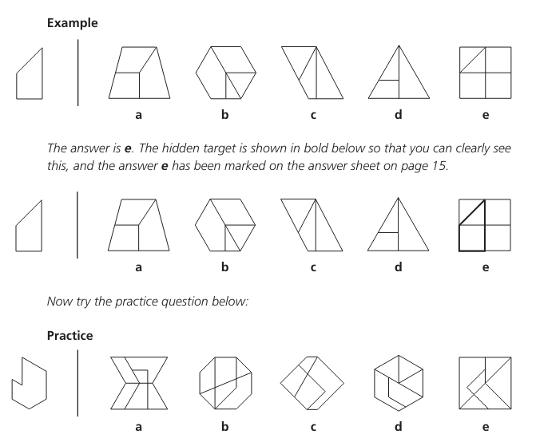
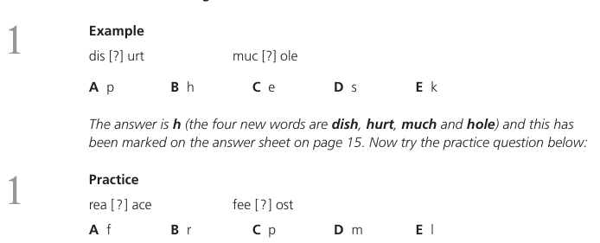
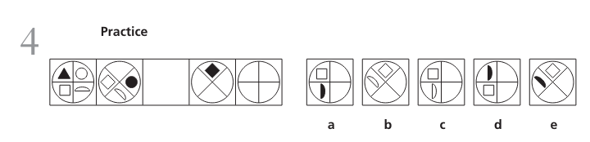
Format
St Nicholas-at-Wade CE Primary A Place to Belong, A Place to Grow

Slide 16
Scoring 2024
To be given a grammar school assessment, children needed a total score of 332 or more, with no single score lower than 107. Test scores range from 69 to 141. The highest possible total score is 423.
Headteacher Appeal:
In some cases, children have been assessed suitable for grammar school via their local Head Teacher Assessment panel, with a score below the 332 total score threshold.
Children may also score higher than 332, but still be assessed as suitable for comprehensive school in cases where 1 or more of their individual scores were below 108.
St Nicholas-at-Wade CE Primary A Place to Belong, A Place to Grow

Slide 17
Appeals
Parent Appeals
kent.admissions@kent.gov.uk
Talk with Mr Neal or Mrs Woodbridge
Decide to appeal or not.
No appeal can take place before March
Independent appeal panel
St Nicholas-at-Wade CE Primary A Place to Belong, A Place to Grow

Slide 18





What do I stand for!
Be the best you can be
At St Nicholas, we believe that personal development is fostered through the values that we hold so dearly ‘Courage, Resilience, Honesty, Kindness and Be the best you can be’, these values are truly as important to the children’s future success as their academic attainment. We refuse to allow children to be defined by exams alone and encourage them to understand that future success is rooted in their ability to work hard, face setbacks, work with others and be kind, this will allow them to develop strategies for meeting their goals and believe in themselves.
Courage
Resilience
Honesty
kindness
Being your
It's the way
best you
St Nicholas-at-Wade CE Primary A Place to Belong, A Place to Grow

Slide 19
What do I stand for!
Useful Documents
https://www.discovery.kent.sch.uk/assets/Kent-Test-Leaflet-for-parents-1.pdf
https://www.kent.gov.uk/__data/assets/pdf_file/0014/14513/Kent-Test-familiarisation-booklet.pdf
https://www.kent.gov.uk/__data/assets/pdf_file/0020/161831/Secondary-Admissions-Scheme-for-2025-26.pdf
St Nicholas-at-Wade CE Primary A Place to Belong, A Place to Grow

