Slide 1
Welcome to Year 4
Thursday 9th September
2021-2022

Slide 2
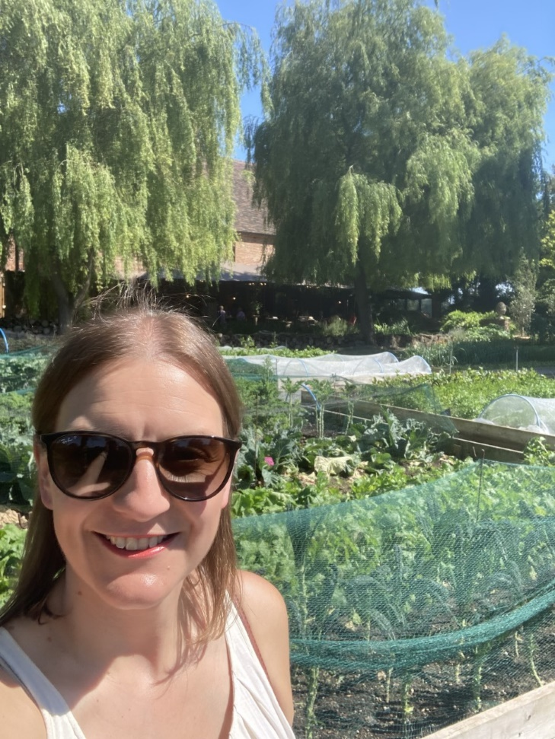
The Adults
Class Teacher:
MISS PATTERSON
Class LSA:
MISS SARAH BARNETT

Slide 3
Fingers Crossed things are back to normal!
Thankfully, we have been given the go ahead to start the year as normal!
Children should:
Arrive at school at 8.45 – registers close at 8.55.
On arrival in the classroom, children MUST continue to sanitise their hands and then sit in their allocated seats to complete Early Morning Work.
The classroom will continue to be ventilated throughout the year, so the children may want to bring an extra jumper
or wear a t-shirt/vest under their school clothes in the winter months.
We are able to go on trips and have visitors in school – This will start with a visit from ZOOLAB for our Predators
topic on Monday the 13th September.
Our break time is 10:45-11:00, lunch is 12:00- 1:00pm.

Slide 4
The 5 B’s and The Hornet
Be respectful
Be kind and gentle
Be careful
Be responsible
Be the best you can be
Hand wash frequently
Obey adults instructions
Remember to keep your distance
Never speak with a mouthful
Every piece of used tissue should go in the bin
Toilets must be flushed after use.
These rules are to keep us ALL safe.

Slide 5
Our Expectations
In Year 4, the pupils happiness and enjoyment for learning is extremely important. I’m a firm believer that if the pupils are feeling happy and comfortable, their confidence will blossom and they will perform at their best.
I expect the pupils to try their best and strive to help them meet their potential. All pupils, like adults, have their strengths and weaknesses and my aim is bring the best out of the children.
PE is on a Monday and a Thursday – you are expected to bring a named school PE kit only – a plain white/school logo t-shirt or a house-coloured t-shirt and a pair of black or dark blue pair of shorts or jogging bottoms.
Please encourage your children to read at home every night. Ideally this would be for at least 30 mins a night. If they have a club after school and this is difficult then 15/20 mins before they go to sleep is much better than nothing. Building up reading stamina and more importantly, a love of books, is so important.

Slide 6
Quality Learning
Pupils should be consistently showing high levels of presentation across all subjects.
Good learning behaviours such as active listening, answering questions, joining in and staying focused at tables will be rewarded through stickers and team points. The team with the highest number of points earns 5 mins extra play on a Friday.
I want the children to be ok with making mistakes! Children should understand that mistakes are part of learning and they should be encouraged to challenge themselves. Hopefully the Year 4’s will have a Growth Mindset and think, this looks challenging but I’m going to try my best.
Whole Class Reading and vocabulary work should have a positive impact on the pupils vocabulary in their independent writing. Pupils will be building on what they learnt in Year 3 and taking their work to the next level.
Times Tables- Please practise these with your children! In Year 4,there is a statutory National Assessment for Times Tables. This is done online in school during the summer term and is out of 35. The pass mark is usually around 33 so they’re really aiming for full marks. The pace of the test is very fast so having quick recall of their tables up to 12 x 12 is vital.

Slide 7
Our School Week
 | Monday | Tuesday | Wednesday | Thursday (SP PPA) | Friday
8.45-9.00 | Register EMW- Spelling | Register EMW-Spelling | Register EMW-Quiet Reading | EMW –Quiet reading Register | Register EMW-Spelling
9.00-9.30 | Worship – Via screen | English | English |  | English
9.30-10.45 | Whole Class Reading 10.15 -10.45 |  |  | PE
 | English | Whole Class Reading 10.15 -10.45 | Whole Class Reading 10.15 -10.45 |  | Whole Class Reading 10.15 -10.45
10.45-11.00 | B | R | E | A | K
11.00 -12.00 | Maths | Maths | Maths | Music | Maths
12.00-1.00 | L | U | N | C | H
1.00-1.05 | Registration | Registration | Registration | Registration | Registration
P.E. 1.05 – 2.10 RE. 2.10 – 3.10 |  | Topic | Topic | English-SPaG | French/Computing 30 mins each
 |  |  |  | Maths | Heartsmart-PHSCE
 |  |  | Class Worship
3.00-3.15 | Class Book/Daily Mile | Class Worship | Class Book/Daily Mile | Class Worship | Worship - Celebration

Slide 8
Homework
My Maths- On a Thursday I will update the MyMaths. If there is not one for a particular week then focus on learning times tables.
Times Tables Practice through TT Rockstars and Hit the button. Hit the button can be found via a google search. Pupils should know their login details for TT Rockstars but I can print them if they have forgotton them.
Homework Projects are once a term based on topic work. The ideas for Predator can be found on our class page on the school website. How these are presented should vary between each term so that they are practising a range of skills. One term could be an Art based project, then an ICT Powerpoint, then a poster etc.
Reading- Should happen daily. This is monitored using accelerated reader. Pupils also record their books and scores on their green reading records in school.
Spellings- Pupils should play Spelling Shed to reinforce the spelling rule for each week. If they do not have a computer they can use one in school in the morning to catch up.

Slide 9
General Reminders
Uniform – KS2 pupils should be role models to the younger children. Please ensure they look smart when entering and leaving school (shirts tucked in, collars done up etc.).
All children must wear their hair up if it is longer than shoulder length.
Names in clothes – Please ensure that your parents have named ALL of your uniform.
Lateness – Please note the school day starts at 8.45: we run groups and catch up sessions in the first 15-20 minutes of the day, so it is really important you are here on time.
Home time – Pupils will be taken out the playground as normal, (parents: please arrive promptly to collect by 3.15.
Appointments – Feel free to approach me in the playground with any queries or questions. If you feel you would prefer more privacy or if it is to discuss something in more detail then please make an appointment via the office and I will be more than happy to help.

Slide 10
Questions
Any questions?

