Slide 1
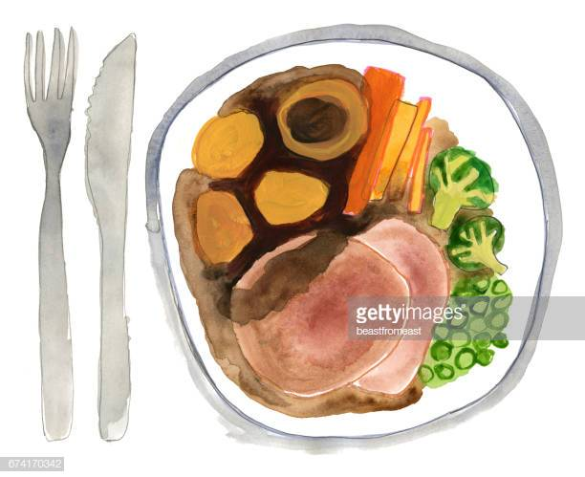
What do I stand for!
Reading Workshop
Phonics
Whole word recognition
Automaticity
Understanding
Prediction
Features of a text
Speaking and listening
Fun and creativity!
Children
St Nicholas-at-Wade CE Primary A Place to Belong, A Place to Grow

Slide 2
What do I stand for!
Little Wandle
New DFE Guidance for Early Reading and Phonics
The journey to independent reading and writing begins with Phonics
littlewandlelettersandsounds.org.uk
Why Little Wandle?
Excellent training for all staff to ensure consistency,
Every aspect of phonics and reading included in a detailed, thorough and
systematic approach,
Engaging resources without distracting from the learning,
Comprehensive system for identifying and supporting children requiring
extra help and useful support for parents.
St Nicholas-at-Wade CE Primary A Place to Belong, A Place to Grow

Slide 3
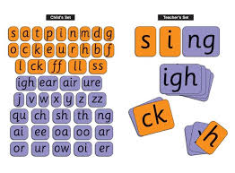
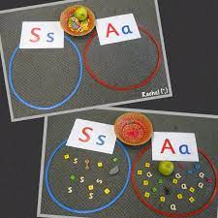
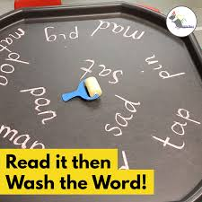
What do I stand for!
How do we teach phonics:
Daily short sessions
Currently taught in Yr R, Yr 1 and into Yr 2 one session a day
Specific order of teaching
Synthetic phonics m-u-s-t Correct pronunciation
is vital - Videos on LW
https://www.littlewandlelettersandsounds.org.uk/resources/for-parents/
Repeated practice - Revisit previously taught sounds at start of each lesson
Practice makes permanent
St Nicholas-at-Wade CE Primary A Place to Belong, A Place to Grow

Slide 4
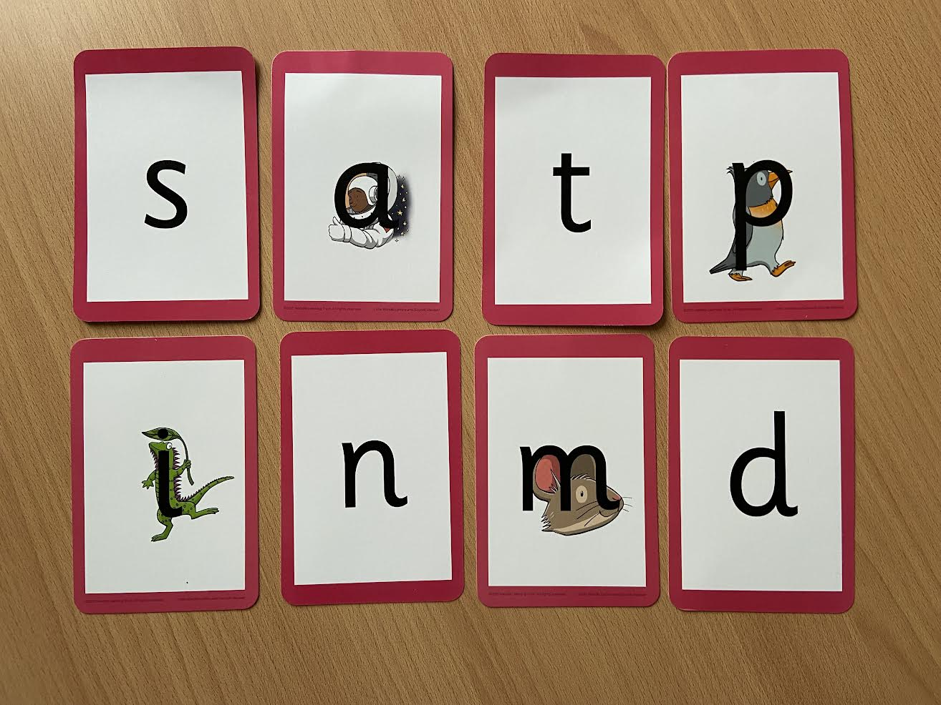
What do I stand for!
Phonemes:
Phonemes taught in order
Start to read words as soon as possible- encourage blending
LW has a picture pnemonic to help children remember the phoneme/grapheme- These will be sent home
St Nicholas-at-Wade CE Primary A Place to Belong, A Place to Grow

Slide 5
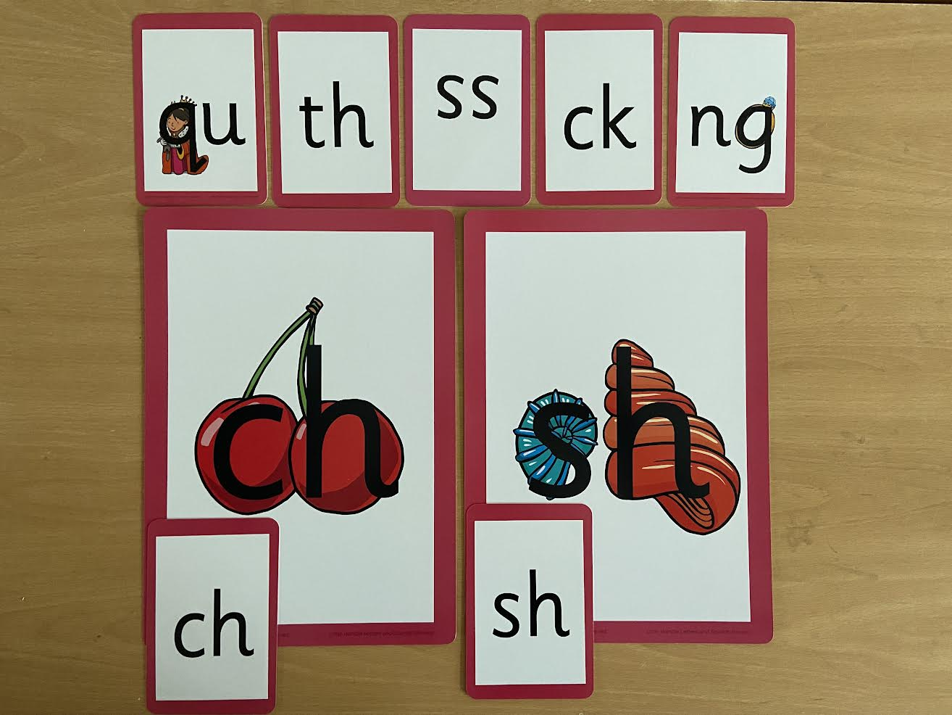
What do I stand for!
Diagraphs:
Two letters that make one sound
St Nicholas-at-Wade CE Primary A Place to Belong, A Place to Grow

Slide 6
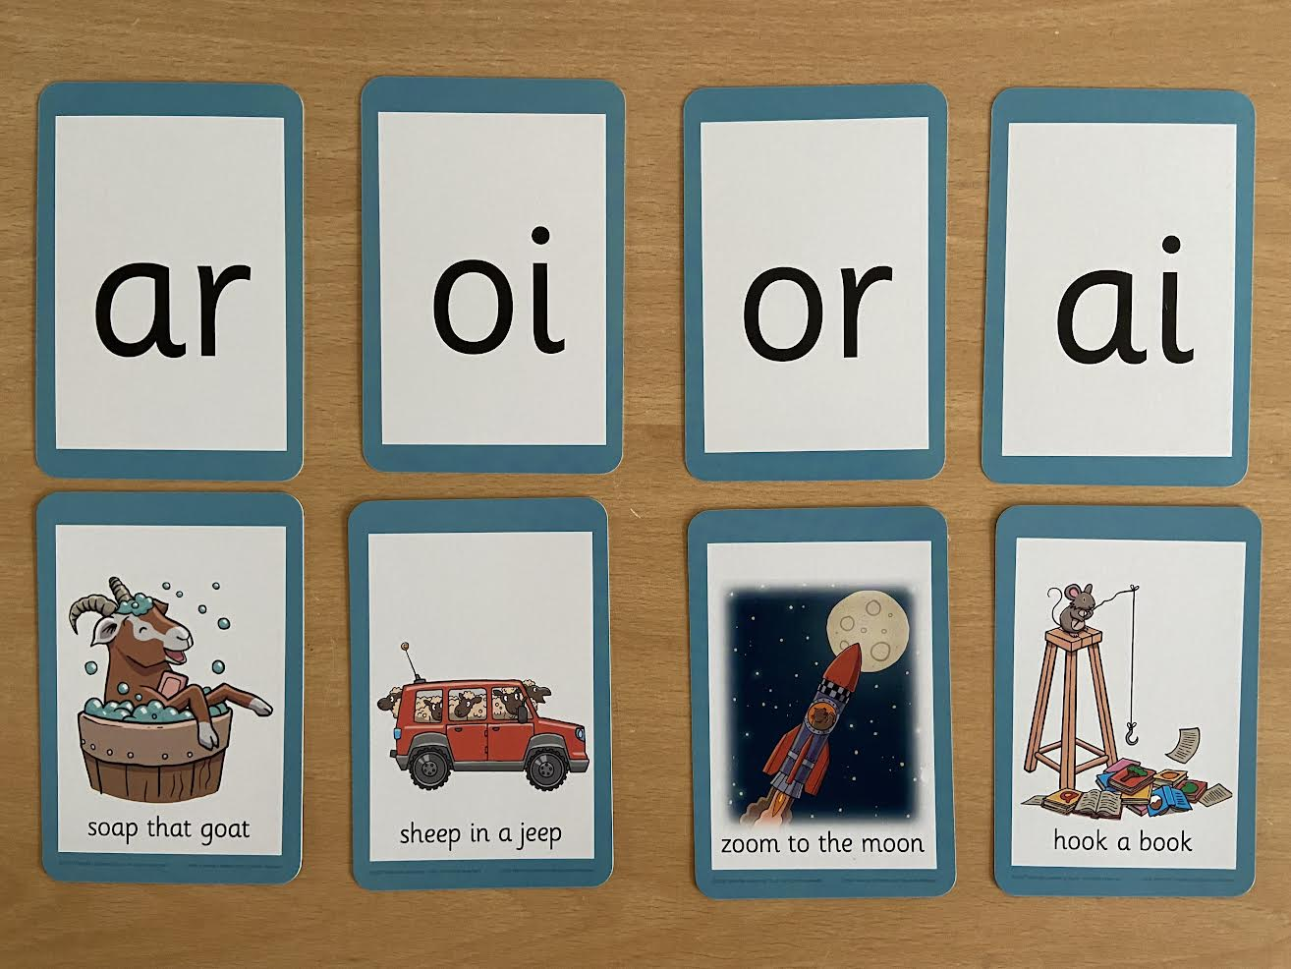
What do I stand for!
Diagraphs/Trigraphs:
The vowel diagraphs are taught with a short caption to help the children to remember
Trigraphs (igh/air) are three letters that make one sound
St Nicholas-at-Wade CE Primary A Place to Belong, A Place to Grow

Slide 7
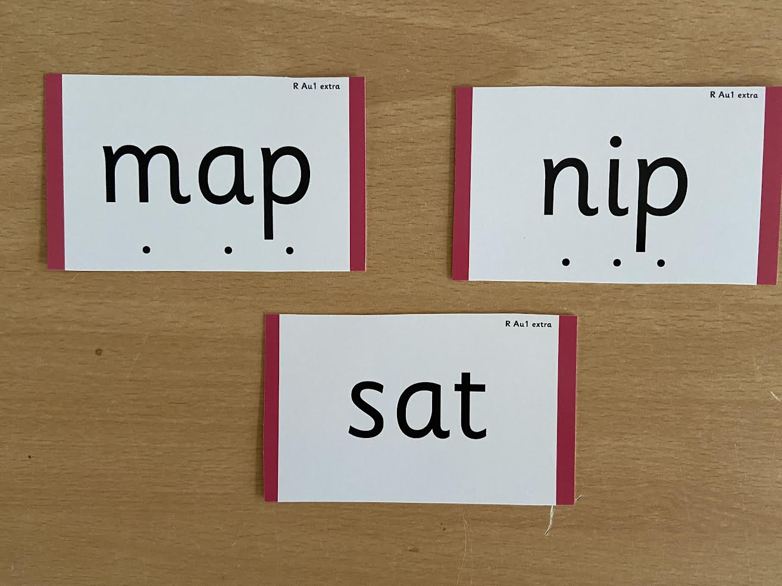
What do I stand for!
Words:
During phonics lessons we use Sound buttons so we can sound talk and blend to read
St Nicholas-at-Wade CE Primary A Place to Belong, A Place to Grow

Slide 8
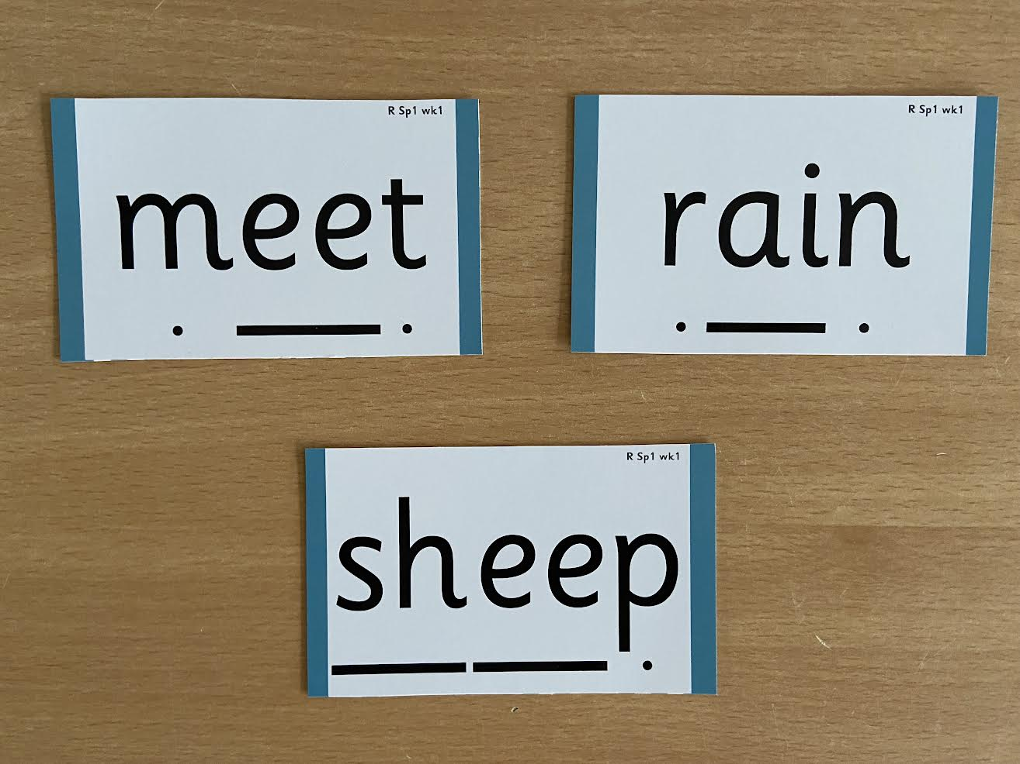
What do I stand for!
Words:
During phonics lessons we use Sound buttons so we can sound talk and blend to read
Digraphs have a dash to sound talk and blend
Letter names are important to know
What a vowel is
St Nicholas-at-Wade CE Primary A Place to Belong, A Place to Grow

Slide 9
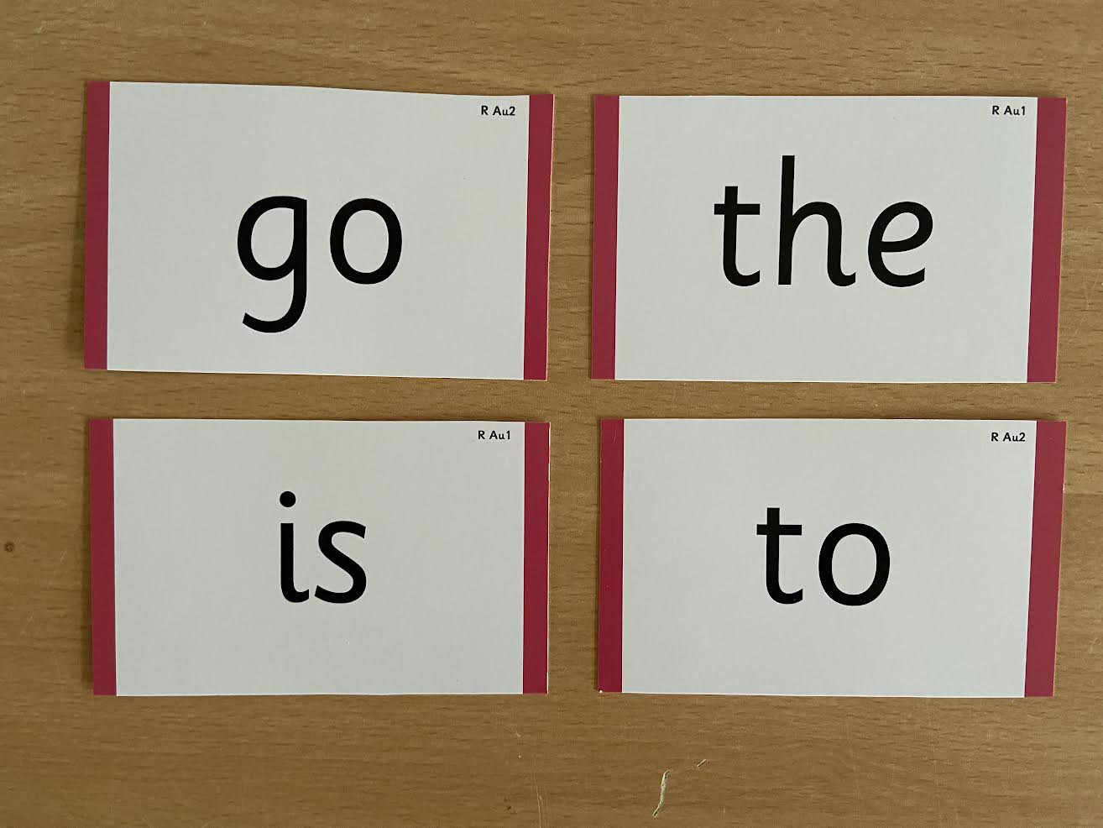
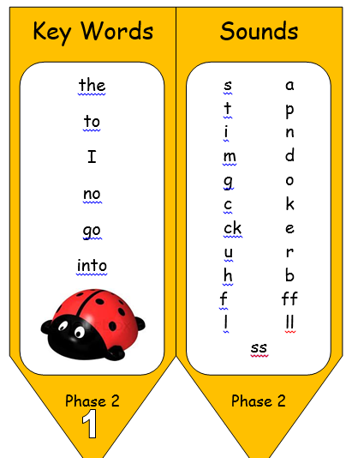
What do I stand for!
Tricky words:
Words that do not follow the rules and cannot be decoded are called tricky words/ exception words
The children are taught what part of the word is tricky
St Nicholas-at-Wade CE Primary A Place to Belong, A Place to Grow

Slide 10
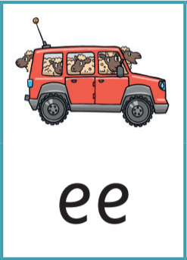
What do I stand for!
Phrases we use at school:
You may hear your children say….
-phonics (also known as ‘synthetic phonics’) – The teaching of reading by developing awareness of the sounds in words and the corresponding letters used to represent those sounds.
phoneme - Any one of the 44 sounds which make up words in the English language.
-grapheme – How a phoneme is written down. There can be more than one way to spell a phoneme. E.g-the phoneme ‘ay’ is spelt differently in each of the words ‘way’, ‘make’, ‘fail’, ‘great’, ‘sleigh’ and ‘lady’.
-blending – Putting together the sounds in a word in order to read it, e.g.
‘f – r – o – g, frog’
-segmenting – Breaking a word into sounds in order to spell
them, e.g. ‘frog, f – r – o – g’’
-Digraph- 2 letters making one sound
-Trigraph- 3 letters making one sound
St Nicholas-at-Wade CE Primary A Place to Belong, A Place to Grow

Slide 11
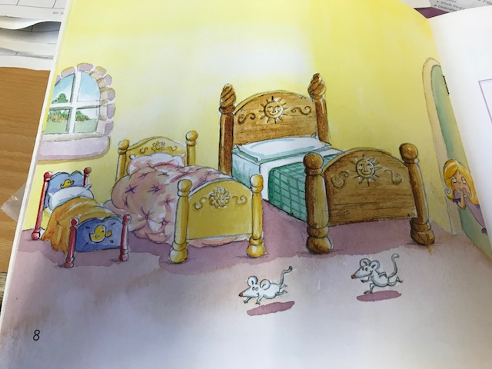
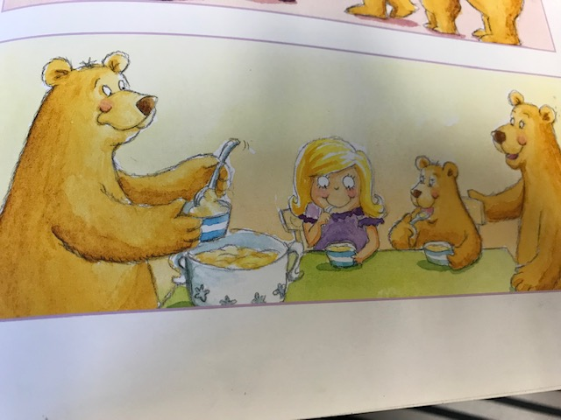
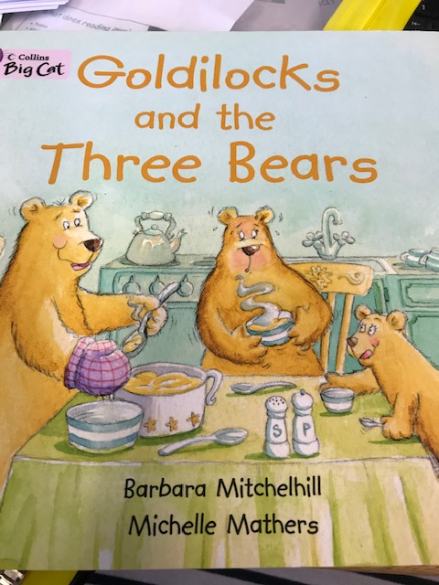
What do I stand for!
Reading-Talking, Talking and Talking!
https://ican.org.uk/i-cans-talking-point/parents/ages-and-stages/
Book talk
Can you re-tell the story? What happened at the beginning, middle and end? How did the characters feel at the start of the story/end?
Who might sleep in these beds? What do you think will happen next in the story?
Who can you see in this story? Do you know any other stories with bears in?
St Nicholas-at-Wade CE Primary A Place to Belong, A Place to Grow

Slide 12
What do I stand for!
Reading-Verbalising Stories:
https://www.youtube.com/watch?v=fepY7OMs00Y&feature=youtu.be
St Nicholas-at-Wade CE Primary A Place to Belong, A Place to Grow

Slide 13
What do I stand for!
Reading-Book Talk:
Hold the book the wrong way round, start reading from the back to the front!
Locate title- what does that tell us?
Names- Introduce Author/Illustrators names
Blurb
Is it fiction or non-fiction?
Talk through the pictures.
Locate HFW words or tricky words.
Look at any features e.g. BOLD, rhyme etc
Letter….letter….word
Chunking of words
Talk through strategies
St Nicholas-at-Wade CE Primary A Place to Belong, A Place to Grow

Slide 14
What do I stand for!
Reading-Re-Reading Texts:
Re-reading a text helps embed these skills
Increases fluency
Helps improve their understanding of a text- takes away de-coding as they are familiar
Help when it comes to writing.
Share pre-empt problems independent reading praise questions
‘If you can’t say it, you can’t write it’
The Teacher Foundation
St Nicholas-at-Wade CE Primary A Place to Belong, A Place to Grow

Slide 15
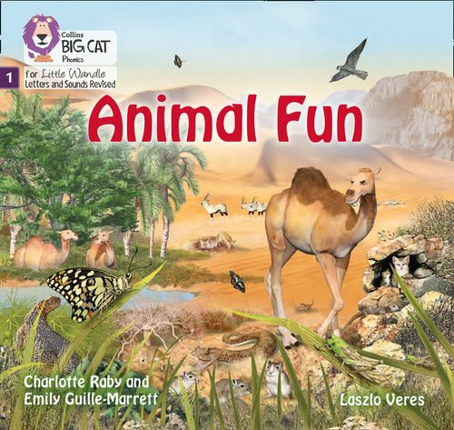
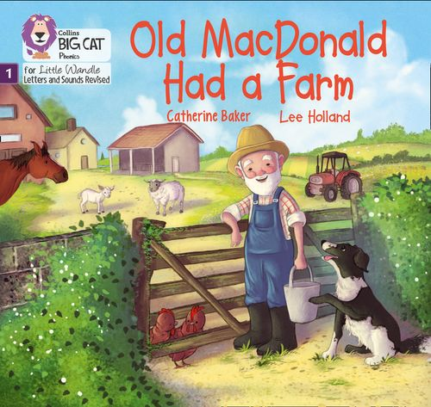
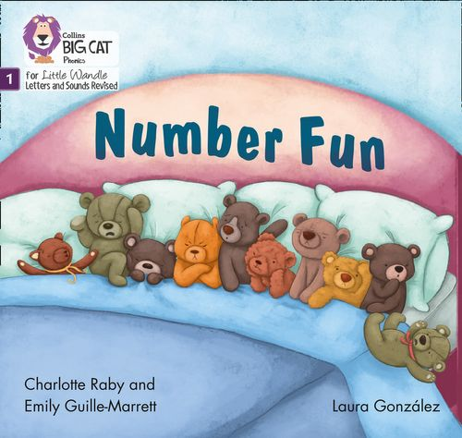
What do I stand for!
Reading-Reading Stages:
Once children have a secure knowledge of a number of GPC’s (Grapheme Phoneme Correspondences) and are confidently blending, they will be ready for reading books.
Prior to this they may have wordless books which develop great language skills and teach children the layout of books and how to handle books
St Nicholas-at-Wade CE Primary A Place to Belong, A Place to Grow

Slide 16
What do I stand for!
Reading-How Reading will look:
Reading practice sessions are :
Books are :
Timetabled 3 times a week
Taught by trained teacher or
teaching assistant
Taught in small groups
matched to children’s secure phonic knowledge and word reading
read three times
sent home
Reading Practice Books carefully matched so children can read fluently and independently
Three reads – each one begins with some quick sounds and words practice
Decoding
Prosody
(intonation, expression)
3. Comprehension
When children take their book home to read they should be 95% fluent. Please do not worry that a book is too easy – your child needs to develop fluency and confidence in reading. Re-reading a book they have had before helps develop fluency – this is the goal.
Celebrate their success!!!
St Nicholas-at-Wade CE Primary A Place to Belong, A Place to Grow

Slide 17
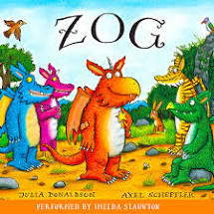
Reading-How Reading will look?
Children are assessed, then LW matches which books should be allocated for their secure phonic knowledge
Children will be set an “E-Book” which will be the Reading Practice Book that they have heard Three times in school. Please celebrate, praise, talk about the book with you child.
A second phonics book will be in their bag that matches their phonics ability.
Children will also bring home a ‘sharing book’ from our class library each week-To become lifelong readers, it is essential that they read for pleasure. Children may not be able to read this book independently but these books offer a wealth of opportunities for talking about the pictures and enjoying the story or information text.
Enjoy the book together and foster a love of reading “pair and share”.
All of these books will only be changed x 1 a week. A comment will be placed in the Reading Record when the books are changed.
Please look after our books
St Nicholas-at-Wade CE Primary A Place to Belong, A Place to Grow
Notes:
Welcome, the purpose of us coming together today is two fold, on one hand is the first of many occasions where we will begin to develop our relationship with each other – others much less formal and thankfully for you, if it’s on the gate in the morning, more briefly ! But crucially, it is a springboard for us to begin to build a partnership and a joined-up approach to your child’s education. And secondly, it is to give you a flavour of St Nicholas, our approach and what you can expect from us, and what we expect from you – so pretty much we are back to the relationship part!
I thought really hard about what you can expect but the best way to articulate what we stand for is quite simply and succinctly put in : APTB/APTG – This truly captures the essence of what you can expect from StNicks and is the absolute foundation on which we will ensure the best outcomes for your children.

Slide 18
What do I stand for!
Reading-What can you do?
Please look at the Little Wandle videos and guidance for parents/Carers
Support children in learning the alphabetic code
Let your child “show off” their reading to you and celebrate and praise all the way!
Share books with your children for pleasure
Check on your class page for documents to support reading and phonics
St Nicholas-at-Wade CE Primary A Place to Belong, A Place to Grow

