Slide 1
Welcome to Year 5
Meet the Teacher

Slide 2
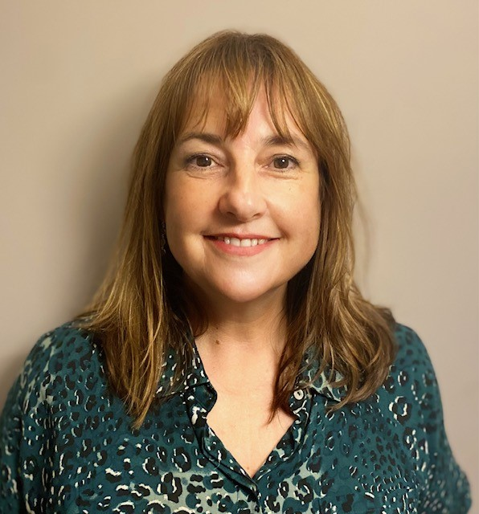
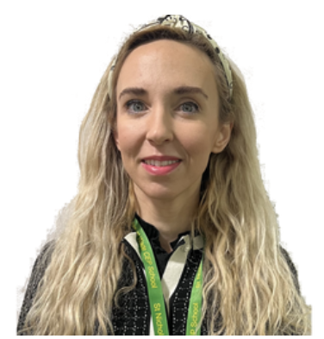
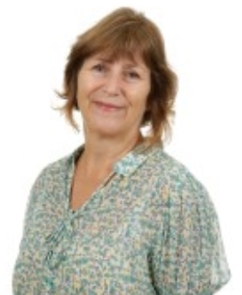
Meet the team
Ms H Woodbridge
Class Teacher
Mrs S Obee
T.A. (mornings)
Mrs V Eley
T.A. (afternoons)

