Slide 1
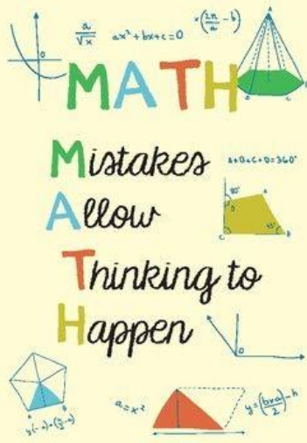
What do I stand for!
Maths Workshop-KS1
What are your memories of maths at school?
How do you feel about maths?
St Nicholas-at-Wade CE Primary A Place to Belong, A Place to Grow

Slide 2
What do I stand for!
Where are we aiming?
The curriculum is designed so that pupils explore mathematical ideas in depth.
• Number – number and place value
• Number – addition and subtraction
• Number – Multiplication and division
• Number – fractions
• Measurement
• Geometry: properties of shape
• Geometry – position and direction
• Statistics (Year 2 only)
The national curriculum for mathematics aims to ensure that all pupils:
• become fluent in the fundamentals of mathematics, including through varied and frequent practice with increasingly complex problems over time, so that pupils develop conceptual understanding and the ability to recall and apply knowledge rapidly and accurately.
• reason mathematically by following a line of enquiry, conjecturing relationships and generalisations, and developing an argument, justification or proof using mathematical language.
• can solve problems by applying their mathematics to a variety of routine and non-routine problems with increasing sophistication, including breaking down problems into a series of simpler steps and persevering in seeking solutions.
St Nicholas-at-Wade CE Primary A Place to Belong, A Place to Grow

Slide 3
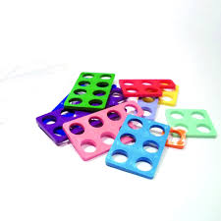
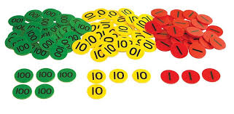
What do I stand for!
Useful maths resources
St Nicholas-at-Wade CE Primary A Place to Belong, A Place to Grow

Slide 4
What do I stand for!
Useful maths resources
St Nicholas-at-Wade CE Primary A Place to Belong, A Place to Grow

Slide 5
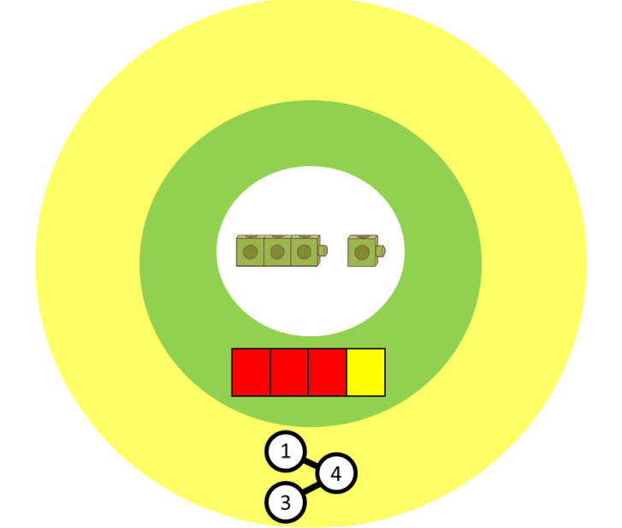
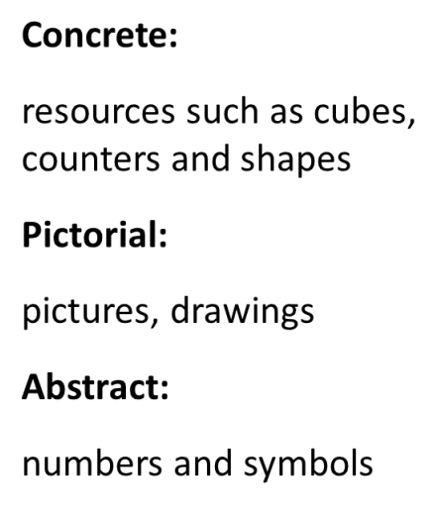
What do I stand for!
Firm foundations
St Nicholas-at-Wade CE Primary A Place to Belong, A Place to Grow

Slide 6
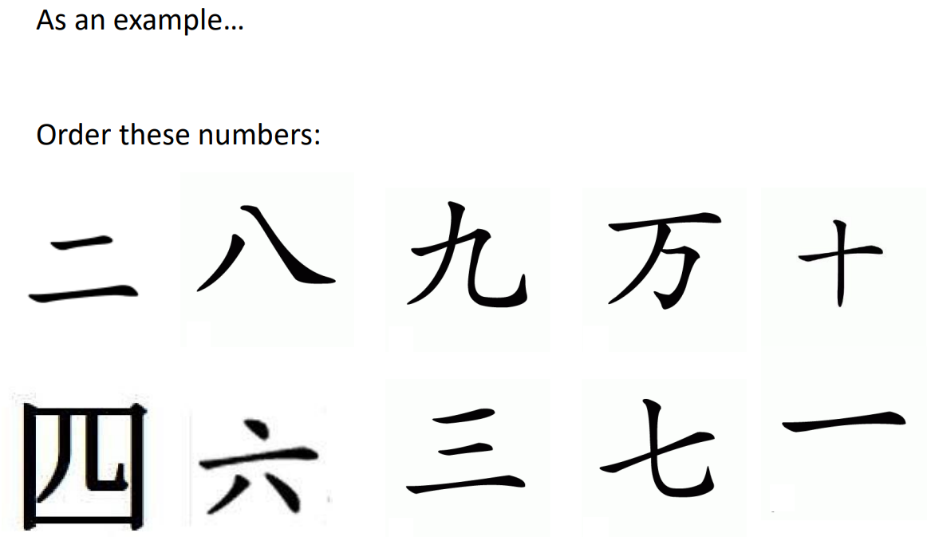
What do I stand for!
What does it look like?
St Nicholas-at-Wade CE Primary A Place to Belong, A Place to Grow

Slide 7
What do I stand for!
What does it look like?
St Nicholas-at-Wade CE Primary A Place to Belong, A Place to Grow

Slide 8
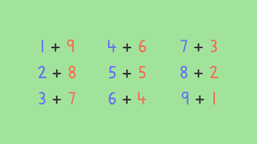
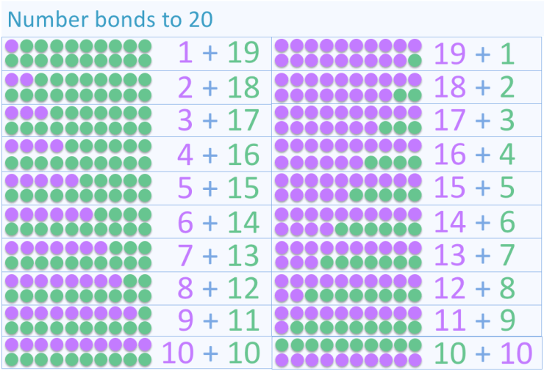
What do I stand for!
Pairs of numbers:
In Years 1 children are solid with learning pairs that total 10 and 20.
This helps children in Year 2 and beyond make connections e.g
If I know 4 and 6 makes 10
40 and 60 makes 100.
St Nicholas-at-Wade CE Primary A Place to Belong, A Place to Grow

Slide 9
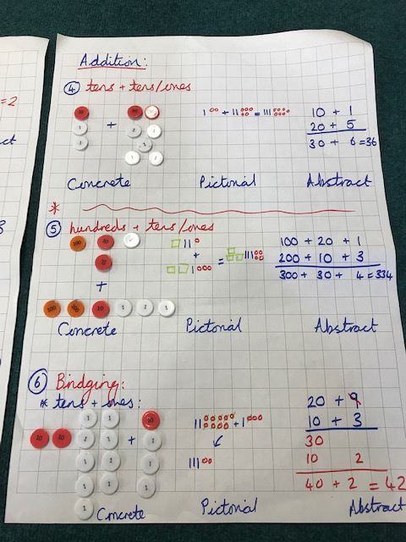
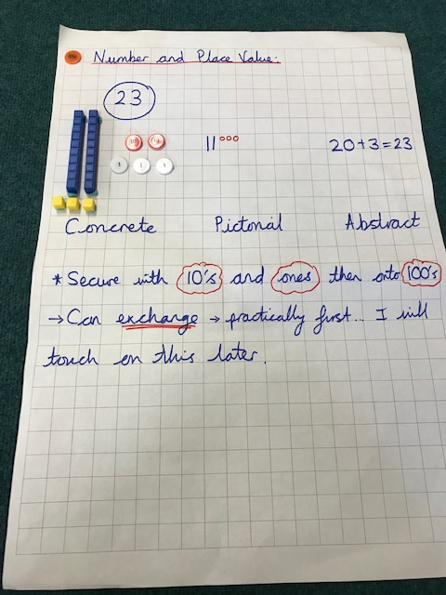
What do I stand for!
Partitioning:
St Nicholas-at-Wade CE Primary A Place to Belong, A Place to Grow

Slide 10
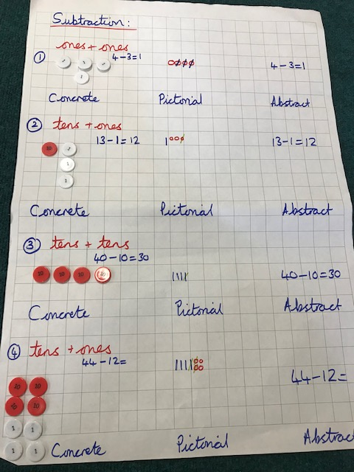
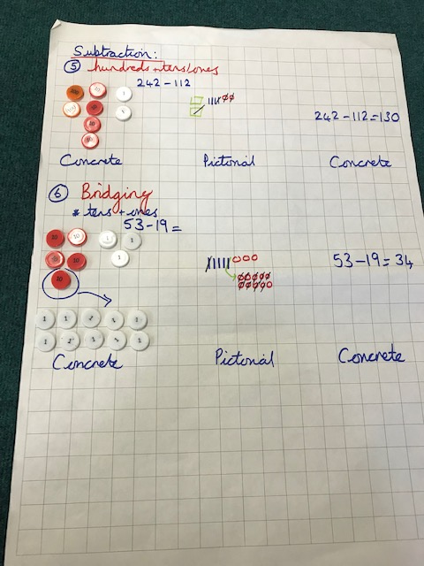
What do I stand for!
Partitioning:
Addition
Children will learn to:
-Use objects/combine two groups (count all, count on from first number, count on from largest number)
-Use number lines/use practical resources to record number sentences
-partition and recombine numbers
-Attempt formal written methods-use an empty number line
Subtraction
Children will learn to:
-relate subtraction as ‘taking away’
-use resources and pictures to record calculations
-use number lines to count back/find the difference
-partition numbers
-use formal written methods
-use an empty number line
St Nicholas-at-Wade CE Primary A Place to Belong, A Place to Grow

Slide 11
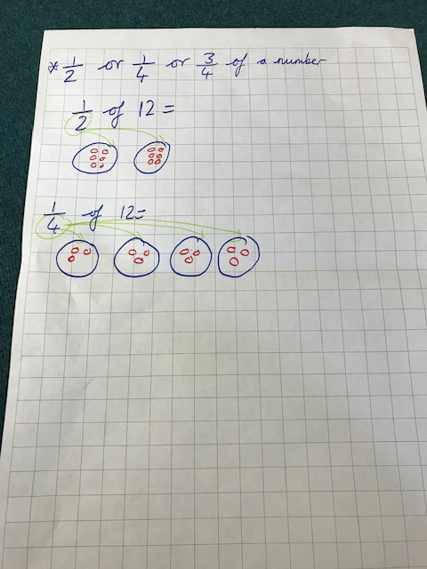
What do I stand for!
Methods:
Multiplication
Children will learn to:
-count in repeated groups
-count in 2’s, 5’s and 10’s
-solve practical problems involving 2’s, 5’s and 10’s
-understand multiplication as repeated addition
-draw arrays
-begin to count in steps of 3 and 4
-use an empty number line
Division
Children will learn to:
-share objects into equal groups
-practical problems/drawing pictures sharing into 2’s, 5’s and 10’s
-relate grouping to arrays
-understand division as repeated subtraction
-use an empty number line
St Nicholas-at-Wade CE Primary A Place to Belong, A Place to Grow

Slide 12
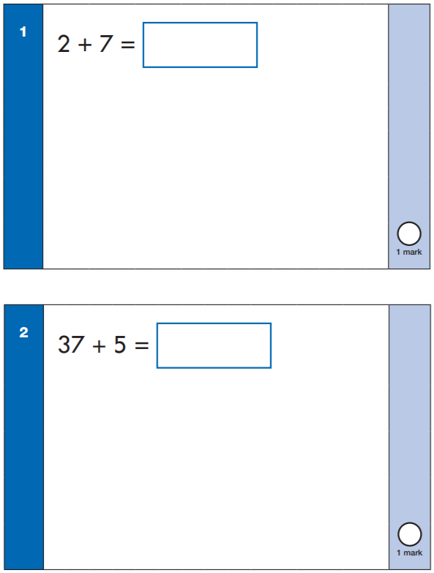
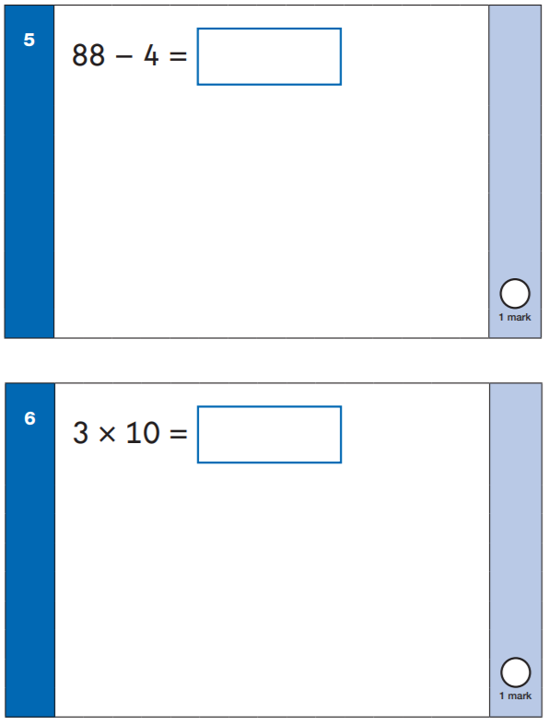
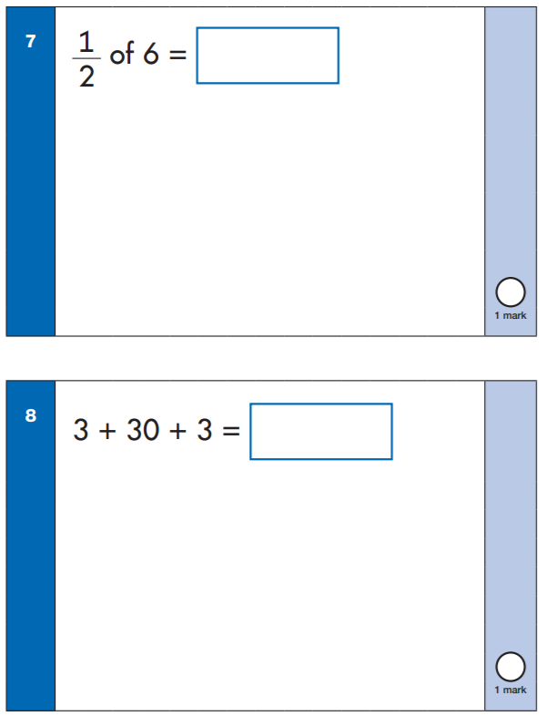
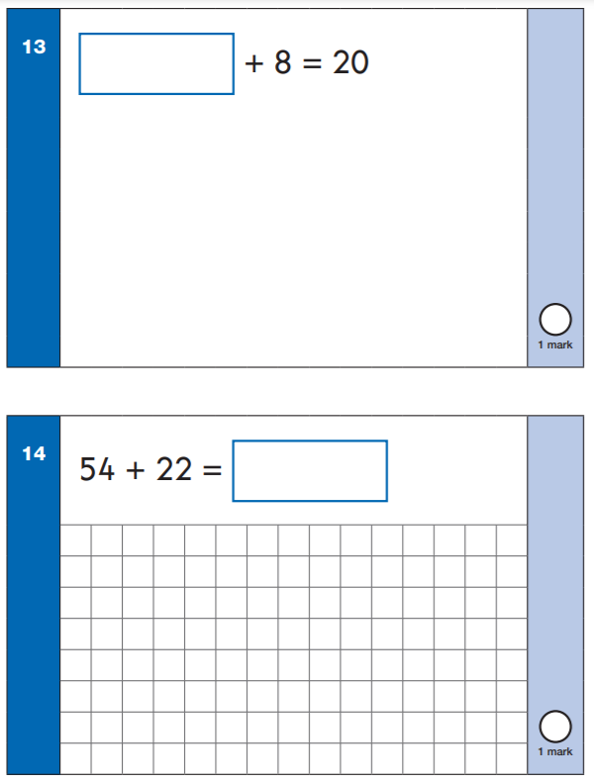
What do I stand for!
Arithmetic:
These are typical arithmetic style questions. The aim is that children can use their own ways of working to solve these questions and use their number knowledge.
St Nicholas-at-Wade CE Primary A Place to Belong, A Place to Grow

Slide 13
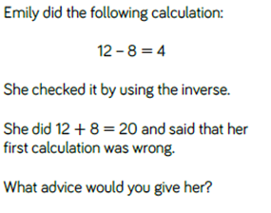
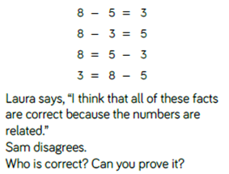
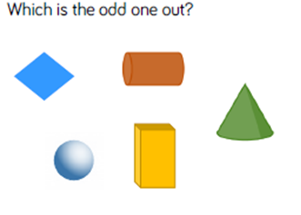
What do I stand for!
Reasoning:
Ways to promote their reasoning and explanation as to HOW they achieved an answer:
St Nicholas-at-Wade CE Primary A Place to Belong, A Place to Grow

Slide 14
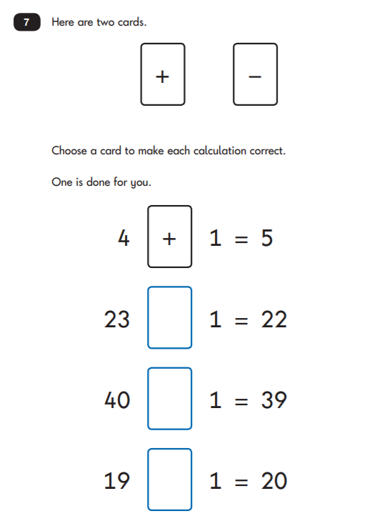
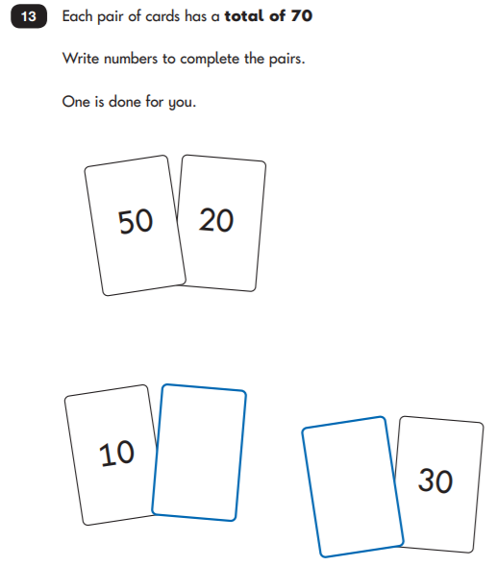
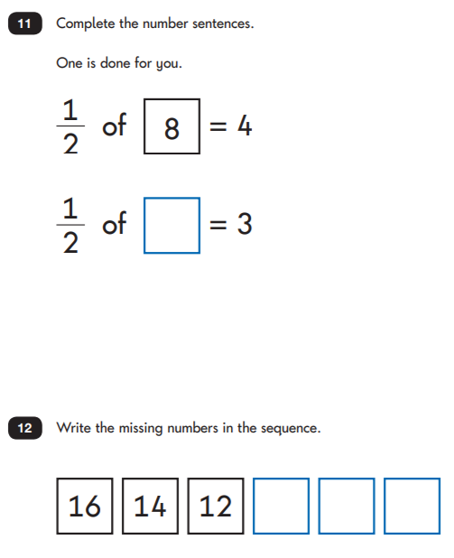
What do I stand for!
Reasoning:
St Nicholas-at-Wade CE Primary A Place to Belong, A Place to Grow

Slide 15
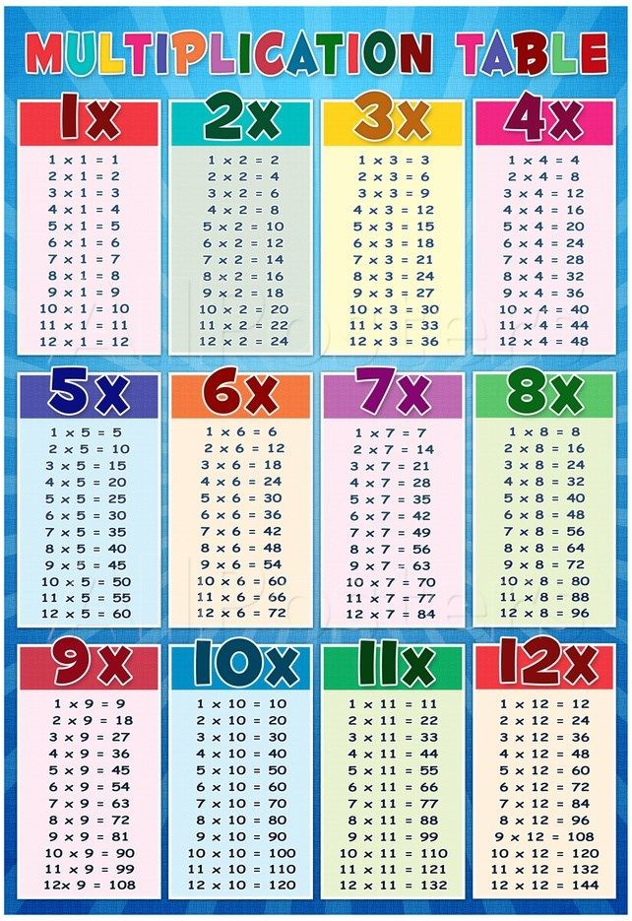
What do I stand for!
Times Tables:
Learning timetables is always a brilliant foundation for children.
Start with 2x, 5x, 10x
Then move onto 3x, 4x, 6x, 7x, 8x, 9x
Counting in number sequences can help them to know the patterns- post-its up the stairs! Which number is missing?
St Nicholas-at-Wade CE Primary A Place to Belong, A Place to Grow

Slide 16
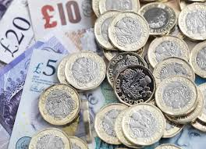
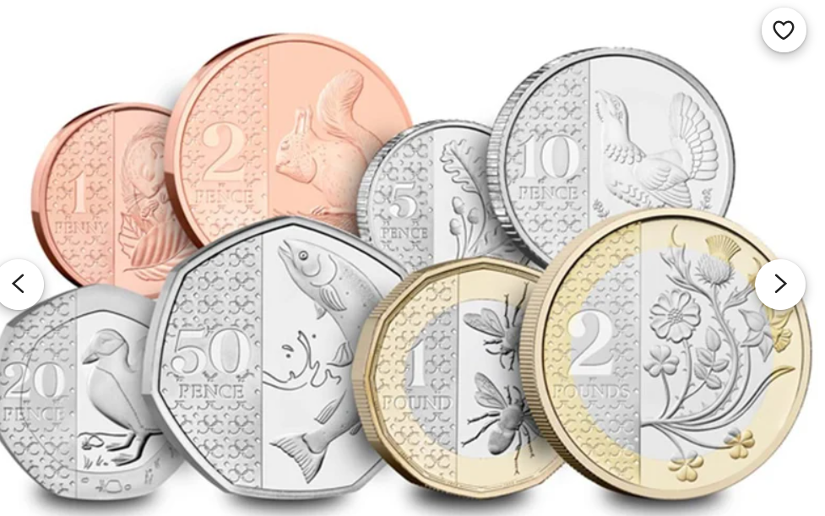
What do I stand for!
Money:
Empty the money jars! Let them use real money. Set a challenge:
Order coins by VALUE from smallest to biggest (up to £5)
Can you find ways to make a total e.g 37p
Can you give change? I go shopping and by some toys for 64p. I use £1. How much change would I get?
St Nicholas-at-Wade CE Primary A Place to Belong, A Place to Grow

Slide 17
What do I stand for!
Scales:
St Nicholas-at-Wade CE Primary A Place to Belong, A Place to Grow

Slide 18
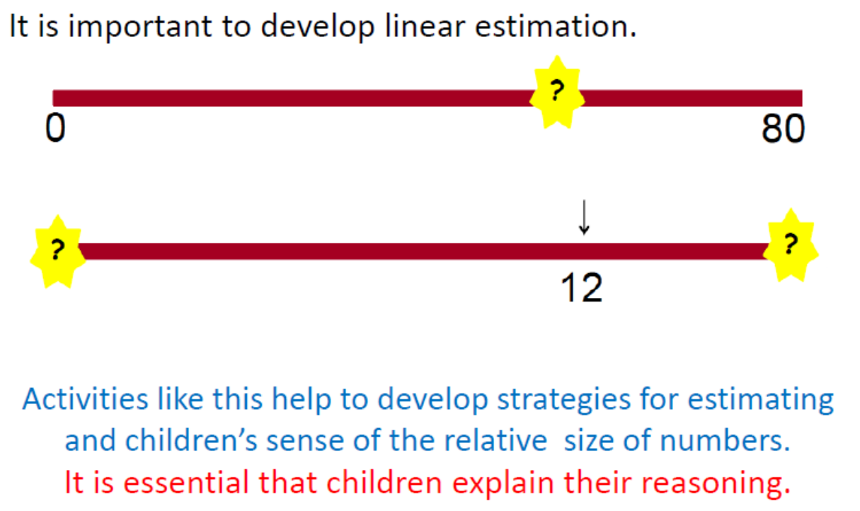
What do I stand for!
Counting:
St Nicholas-at-Wade CE Primary A Place to Belong, A Place to Grow

Slide 19
What do I stand for!
Part whole model:
St Nicholas-at-Wade CE Primary A Place to Belong, A Place to Grow

Slide 20
What do I stand for!
Part whole model:
St Nicholas-at-Wade CE Primary A Place to Belong, A Place to Grow

Slide 21
What do I stand for!
Part whole model:
St Nicholas-at-Wade CE Primary A Place to Belong, A Place to Grow

Slide 22
What do I stand for!
Part whole model:
St Nicholas-at-Wade CE Primary A Place to Belong, A Place to Grow

Slide 23
What do I stand for!
Resources:
1 minute maths app- White Rose
Home learning- White Rose videos
Times Tables Rockstars
Michael- White Rose maths
St Nicholas-at-Wade CE Primary A Place to Belong, A Place to Grow

Slide 24
What do I stand for!
Top tips:
Practise written methods to solve problems
Underline key words in questions
Use of a ruler as a number line
Pairs to 10/20.
Fluency is key – Number facts
Multiplication- 2s/5s/10s/3s/4s(from 2s) and 6s (from 3s)
Including subtraction facts as well.
Doubles/near doubles and halves – Skip counting – Timetables
Practise, practise, practise!
Other activities can include: – Practise writing number formation – Match words to numbers
Think and talk like a mathematician example
St Nicholas-at-Wade CE Primary A Place to Belong, A Place to Grow

