Slide 1
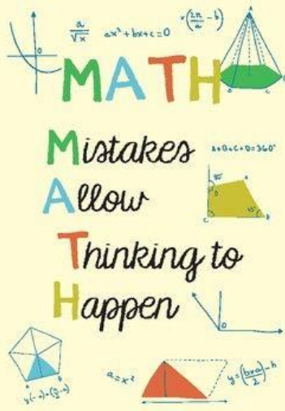
What do I stand for!
Maths Workshop
What are your memories of maths at school?
How do you feel about maths?
St Nicholas-at-Wade CE Primary A Place to Belong, A Place to Grow

Slide 2
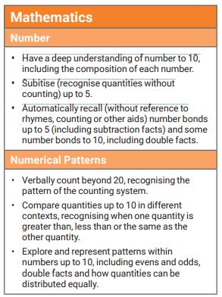
What do I stand for!
Where are we aiming?
Deep understanding
St Nicholas-at-Wade CE Primary A Place to Belong, A Place to Grow

Slide 3
What do I stand for!
What is counting?
We often want to rush to using symbols in maths and counting is no different.
Our aim is to help children to develop a firm grasp of counting before we formally introduce the symbol of a number.
St Nicholas-at-Wade CE Primary A Place to Belong, A Place to Grow

Slide 4
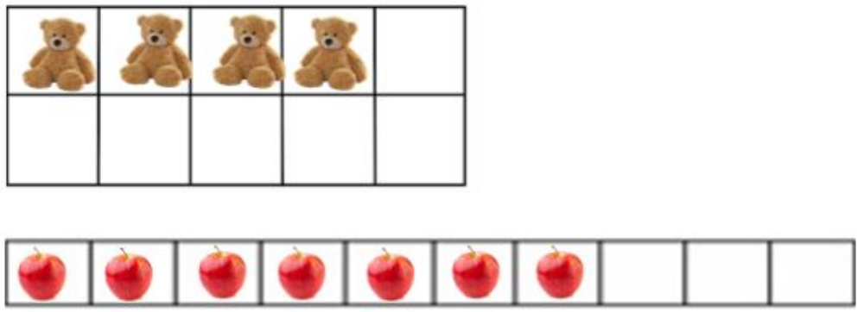
What do I stand for!
Counting:
5 Counting Principles
1. One-one Correspondence principle
Understanding that each object counted must be given one count and only one count.
St Nicholas-at-Wade CE Primary A Place to Belong, A Place to Grow

Slide 5
What do I stand for!
Counting:
2. Stable order principle
Understanding that counting sequence stays consistent. It is always 1, 2, 3, 4, 5, 6, 7 etc
Not 1, 2, 4, 5, 7
Can your child spot your mistake?
Nursery rhymes, practise counting in a variety of different things in different ways.
St Nicholas-at-Wade CE Primary A Place to Belong, A Place to Grow

Slide 6
What do I stand for!
Counting:
3. Cardinal principles
Understanding the last count of a group of objects represents how many are in the group.
Keep modelling: There are 1, 2, 3 marbles in the jar. There are 3 marbles.
St Nicholas-at-Wade CE Primary A Place to Belong, A Place to Grow

Slide 7
What do I stand for!
Counting:
4. Abstraction principle
Understanding the it doesn’t matter what you count, how we count stays the same.
For example any sets of objects can be counted as a set, regardless of whether they are the same colour, shape, size, etc.
This can also include non- physical things such as sounds, imaginary objects, etc.
St Nicholas-at-Wade CE Primary A Place to Belong, A Place to Grow

Slide 8
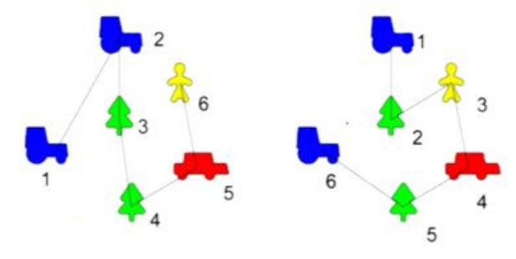
What do I stand for!
Counting:
5. Order irrelevance
Knowledge that the order that items are counted in is irrelevant as long as every object in the set is given one count and only one count.
Re-count real objects that can be touched starting from different positions.
St Nicholas-at-Wade CE Primary A Place to Belong, A Place to Grow

Slide 9
What do I stand for!
Understanding of number:
St Nicholas-at-Wade CE Primary A Place to Belong, A Place to Grow

Slide 10
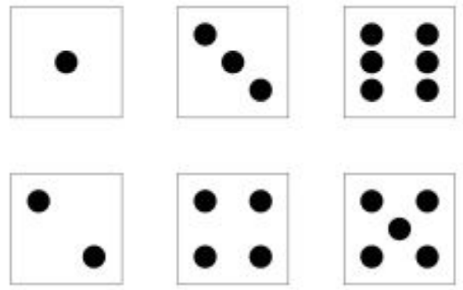
What do I stand for!
Subitising:
It is the ability to quickly recognise how many objects are in a group without actually counting.
Reinforces principles of counting and beyond.
What numbers are represented here?
St Nicholas-at-Wade CE Primary A Place to Belong, A Place to Grow

Slide 11
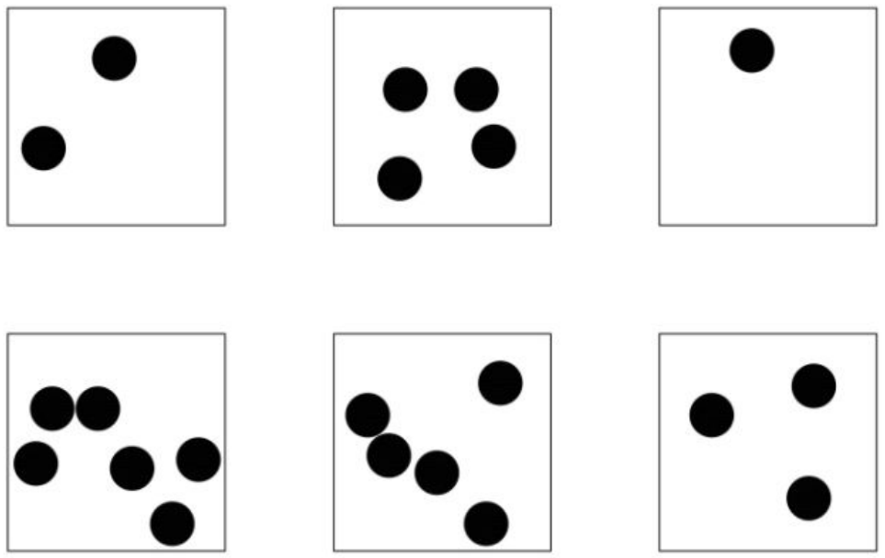
What do I stand for!
Subitising:
What numbers are represented here?
St Nicholas-at-Wade CE Primary A Place to Belong, A Place to Grow

Slide 12
What do I stand for!
How did you see the number?
What numbers can you see hidden?
St Nicholas-at-Wade CE Primary A Place to Belong, A Place to Grow

Slide 13
What do I stand for!
Number patterns:
I know 1 and 3 makes 4.
2 more than 4 is 6.
There are more ways to recognise 6. By asking the children to investigate images and talk about what they can see helps children develop their understanding of different numbers.
St Nicholas-at-Wade CE Primary A Place to Belong, A Place to Grow

Slide 14
What do I stand for!
Number patterns:
What numbers can you see hidden?
St Nicholas-at-Wade CE Primary A Place to Belong, A Place to Grow

Slide 15
What do I stand for!
Number patterns:
What numbers can you see hidden?
Also developing positional language: next to, underneath, above, at the side.
St Nicholas-at-Wade CE Primary A Place to Belong, A Place to Grow

Slide 16
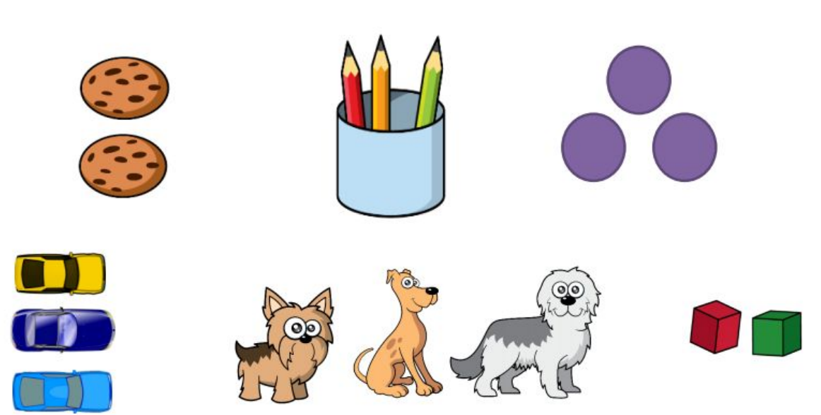
What do I stand for!
Number patterns:
Not just dots….
St Nicholas-at-Wade CE Primary A Place to Belong, A Place to Grow

Slide 17
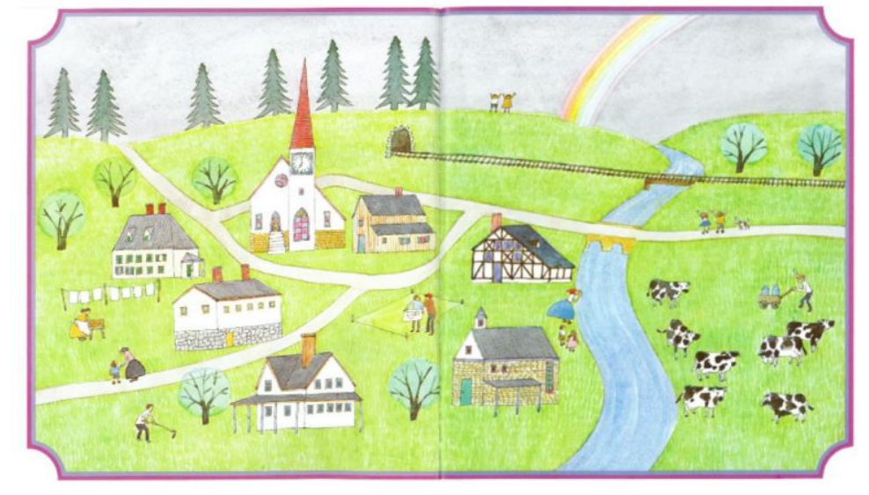
Subitising in the environment:
How many times can you see 7 objects?
St Nicholas-at-Wade CE Primary A Place to Belong, A Place to Grow
Notes:
Welcome, the purpose of us coming together today is two fold, on one hand is the first of many occasions where we will begin to develop our relationship with each other – others much less formal and thankfully for you, if it’s on the gate in the morning, more briefly ! But crucially, it is a springboard for us to begin to build a partnership and a joined-up approach to your child’s education. And secondly, it is to give you a flavour of St Nicholas, our approach and what you can expect from us, and what we expect from you – so pretty much we are back to the relationship part!
I thought really hard about what you can expect but the best way to articulate what we stand for is quite simply and succinctly put in : APTB/APTG – This truly captures the essence of what you can expect from StNicks and is the absolute foundation on which we will ensure the best outcomes for your children.

Slide 18
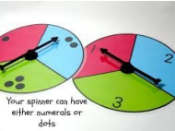
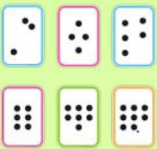
What do I stand for!
Subitising in class/home?
Number pairs
Quick flashcards
Bingo
Number treasure hunt
Find a number the same as mine, more than, less than mine
Dice game and spinners
Domino games
St Nicholas-at-Wade CE Primary A Place to Belong, A Place to Grow

Slide 19
What do I stand for!
What does subitising help with?
Numbers are composed of smaller numbers
Numbers can be made of 2 parts
Numbers can be made of more than 2 parts
Numbers can be made of equal parts
Numbers can be made of unequal parts
St Nicholas-at-Wade CE Primary A Place to Belong, A Place to Grow

Slide 20
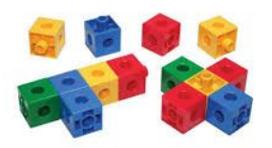
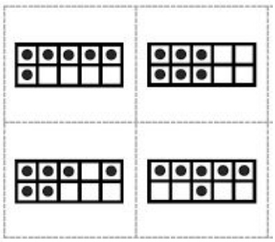
What do I stand for!
Resources:
What can you build with cubes?
6 is 5 and 1
How can you place 6 counters onto the 10s frame? What hidden numbers can you see?
St Nicholas-at-Wade CE Primary A Place to Belong, A Place to Grow

Slide 21
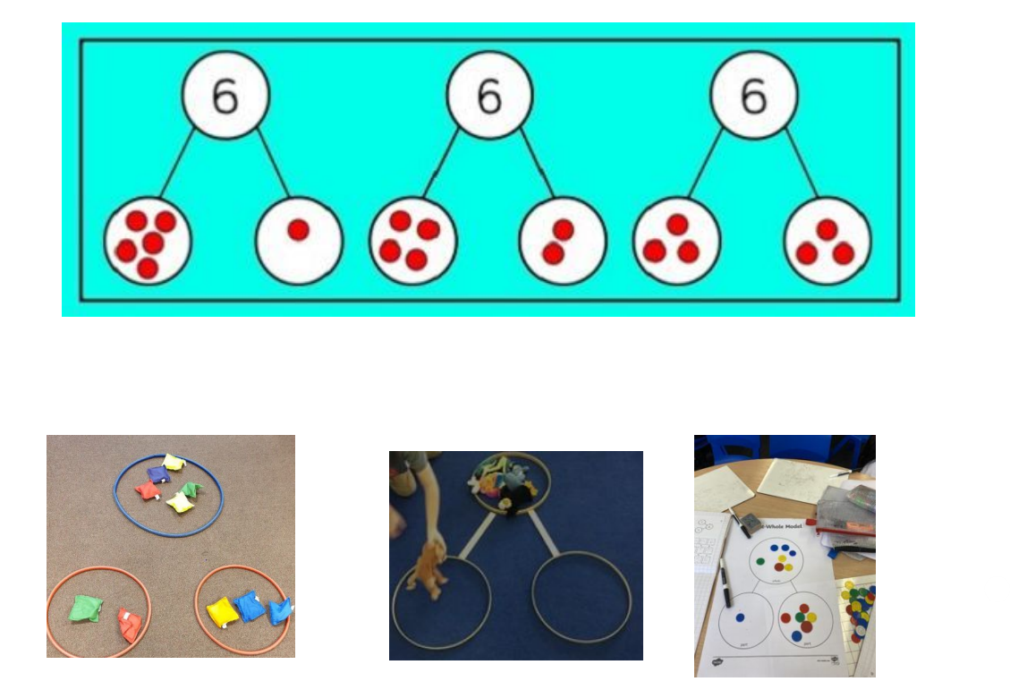
What do I stand for!
Part whole model:
St Nicholas-at-Wade CE Primary A Place to Belong, A Place to Grow

Slide 22
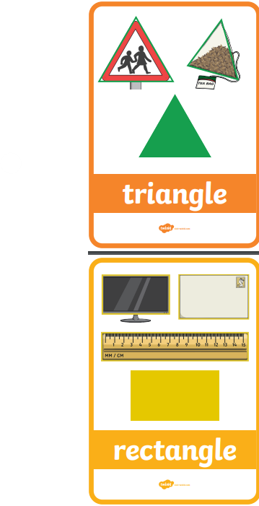
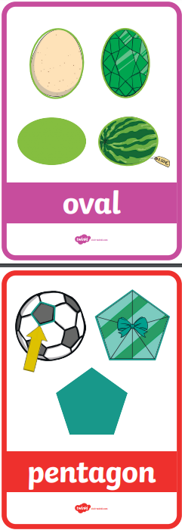
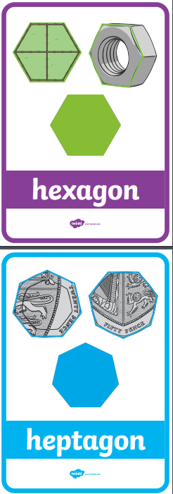
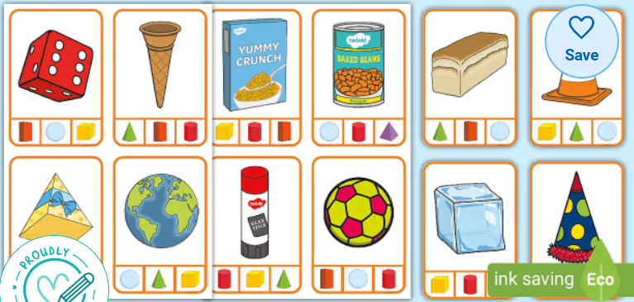
What do I stand for!
Shapes:
Naming 2D and 3D shapes in environment.
2D shapes are flat
3D shapes are FAT!
St Nicholas-at-Wade CE Primary A Place to Belong, A Place to Grow

Slide 23
What do I stand for!
Maths in the environment:
Numbers/shapes/colours in the environment…..I spy a shape and it has three corners…what is it?
Quantities for cooking- Is there enough? Can you fill the cup so it is full/half full? Is there more sugar/flour?
Fitting flat pack together- Is that piece long enough? Do you think we need the shorter piece?
Sorting washing- matching socks
Laying the table- I need four knives….. I have three spoons how many more do I need to make 4four?
Money- let them use it!
Position- Can you put your shoes on top of the step….
St Nicholas-at-Wade CE Primary A Place to Belong, A Place to Grow

Slide 24
What do I stand for!
Top tips:
When subtracting, take items away/cross them off/ cover them over so that they can physically see the change. Vice versa with addition.
Use of language- add it in…just like reading-be ambitious! Say it in different ways e.g subtract/take away/minus
Number formation- Rhymes we do
Bathtime/walking to school- What comes next…”2,3,4…” Show me “3!” Can you make it a different way?
St Nicholas-at-Wade CE Primary A Place to Belong, A Place to Grow

Slide 25
What do I stand for!
A skill for the future:
St Nicholas-at-Wade CE Primary A Place to Belong, A Place to Grow

