Slide 1
Welcome to Year 4
2024 -25

Slide 2
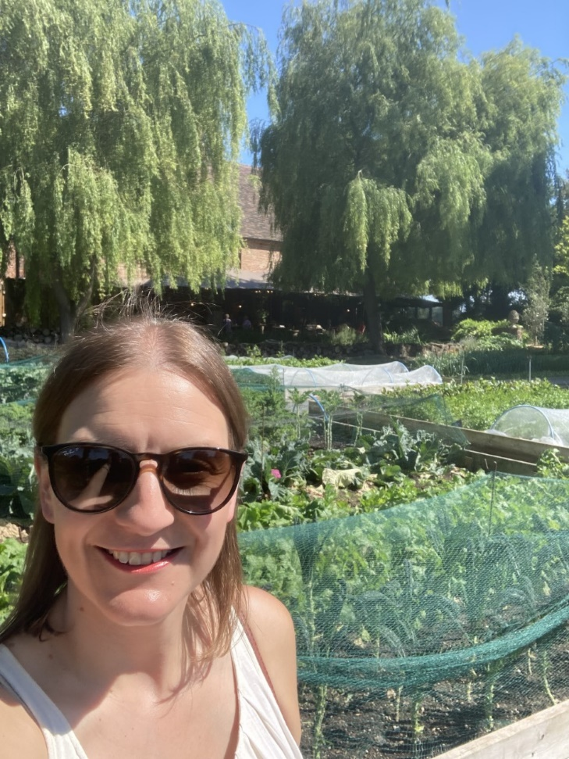
The Adults
Class Teacher:
MISS PATTERSON
Class LSA:
MRS REBECCA EAVES

Slide 3
Our Expectations
In Year 4, the pupils happiness and enjoyment for learning is extremely important. I’m a firm believer that if the pupils are feeling happy and comfortable, their confidence will blossom and they will perform at their best.
I expect the pupils to try their best and strive to help them meet their potential. All pupils, like adults, have their strengths and weaknesses and my aim is bring the best out of the children.
PE is on a Monday and a Wednesday – you are expected to bring a named school PE kit on a Monday – a plain white/school logo t-shirt or a house-coloured t-shirt and a pair of black or dark blue pair of shorts or jogging bottoms. Pupils wear their kit to school on a Wednesday.
Please encourage your children to read at home every night. Ideally this would be for at least 30 mins a night. If they have a club after school and this is difficult then 15/20 mins before they go to sleep would be ideal. Building up reading stamina and more importantly, a love of books, is so important.

Slide 4
Quality Learning
Pupils should be consistently showing high levels of presentation across all subjects.
Good learning behaviours such as active listening, answering questions, joining in and staying focused at tables will be rewarded through stickers and team points. The team with the highest number of points earns 5 mins extra play on a Friday.
I want the children to be ok with making mistakes! Children should understand that mistakes are part of learning and they should be encouraged to challenge themselves. Hopefully the Year 4’s will have a Growth Mindset and think, this looks challenging but I’m going to try my best.
Whole Class Reading and vocabulary work should have a positive impact on the pupils vocabulary in their independent writing. Pupils will be building on what they learnt in Year 3 and taking their work to the next level.
Times Tables- Please practise these with your children! In Year 4,there is a statutory National Assessment for Times Tables. This is done online in school during the summer term and is out of 35. The pass mark is usually around 33 so they’re really aiming for full marks. The pace of the test is very fast so having quick recall of their tables up to 12 x 12 is vital.

Slide 5
Homework
My Maths- On a Thursday I will update the MyMaths. If there is not one for a particular week then focus on learning times tables.
Times Tables Practice through TT Rockstars and Hit the button. Hit the button can be found via a google search. Pupils should know their login details for TT Rockstars but I can print them if they have forgotton them.
Homework Projects are once a term based on topic work. How these are presented should vary between each term so that they are practising a range of skills. One term could be an Art based project, then an ICT Powerpoint, then a poster etc.
Reading- Should happen daily. This is monitored using accelerated reader. Pupils also record their reading in their green reading diary.
Spellings- Pupils should play Spelling Shed to reinforce the spelling rule for each week. If they do not have a computer they can use one in school in the morning to catch up.

Slide 6
General Reminders
Uniform – KS2 pupils should be role models to the younger children. Please ensure they look smart when entering and leaving school (shirts tucked in, collars done up etc.).
All children must wear their hair up if it is longer than shoulder length.
Names in clothes – Please ensure that your parents have named ALL of your uniform.
Arrive on time – Please note the school day starts at 8.35, learning begins from that time so please ensure pupils are in school on time.
Home time – Pupils will be taken out the playground as normal, parents: please arrive promptly to collect by 3.15.
Appointments – Feel free to approach me in the playground with any queries or questions. If you feel you would prefer more privacy or if it is to discuss something in more detail then please make an appointment via the office and I will be more than happy to help.

Slide 7
Questions
Any questions?

